Slide 1


Hii,
IamSiddhika
Welcome to Power BI Series
Part -74

Slide 2



I’m very excited to dive into this with you all!
Are you ready to enhance your data visualization skills?
We focus only on the most used and important Visuals
Today Content
VISUALIZING DATA
DRILL THROUGH
SETUP OF DRILL THROUGH & EXAMPLE

Slide 3


DRILL THROUGH
check next slide ..
Drill Through allows you to create a focused report page that users can navigate to by right-clicking on a data point in another report page. This focused page can show detailed information about that specific data point, making it easy to get in-depth insights.
When to Use Drill Through
Detailed Analysis: When you need to provide a deeper dive into specific aspects of your data.
Contextual Insights: To provide more context and detailed information about a particular data point without cluttering the main report page.
Interactive Reporting: To allow users to explore data interactively by investigating particular areas of interest.

Slide 4


STEPS TO SET UP DRILL THROUGH
1. Create a Drill Through Page:
Create a new report page in Power BI.
lets try with
an example
show detailed information. For example, a table or chart
next..
Add visuals to this page to
displaying details of a product with all necessary fields to that table.
Go to Page information section in Format pane>go to Page Type> Select drill through Option .
Drag the fields you want to drill through on (e.g., Category) to the Drill through from.
2. Set Up the Main Page:
On the main report page, create a visual that summarizes the data. For example, a bar chart showing total sales by category.

Slide 5

Example
Suppose you have a report with sales data, and you want to drill through from a summary page to a detailed sales report based on the selected category’
I have created :
Main Page Visual: A bar chart showing total sales by category. Drill Through Page: A detailed table showing Year, Category, Sub Category, Product, Revenue, Order Quantity, and Total Orders.
How to Use Drill Through:
Navigate to the Main Page:
View the bar chart with sales by category.
Perform Drill Through:
Right-click on the bar representing any category in the bar chart. Select "Drill through" > [Name of the detailed report page].
View Detailed Information:
The detailed report page opens, showing a table with Year, Category, Sub Category, Product, Revenue, Order Quantity, and Total Orders for the selected category.
check next
page visualy
understand

Slide 6
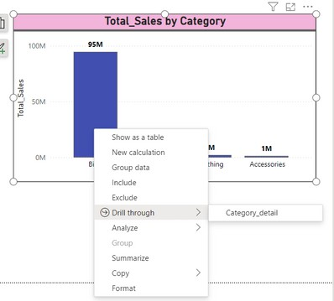
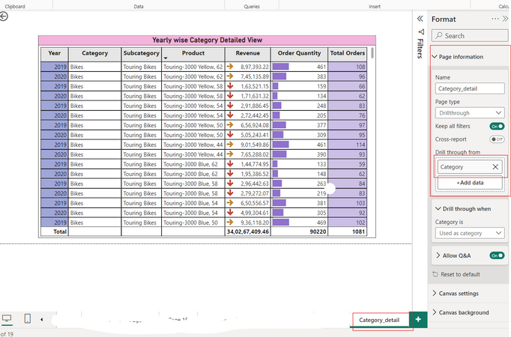
DRILL THROUGH VISUAL EXAMPLE
Try it

Slide 7


Thank you for joining me today to learn about Part -74 of Power BI!
Remember, Effective data visualization is crucial for turning data into meaningful insights and compelling narratives with Power BI.
Stay tuned for more insights and tips on Power BI in our next Series.
Follow

